Slide 1
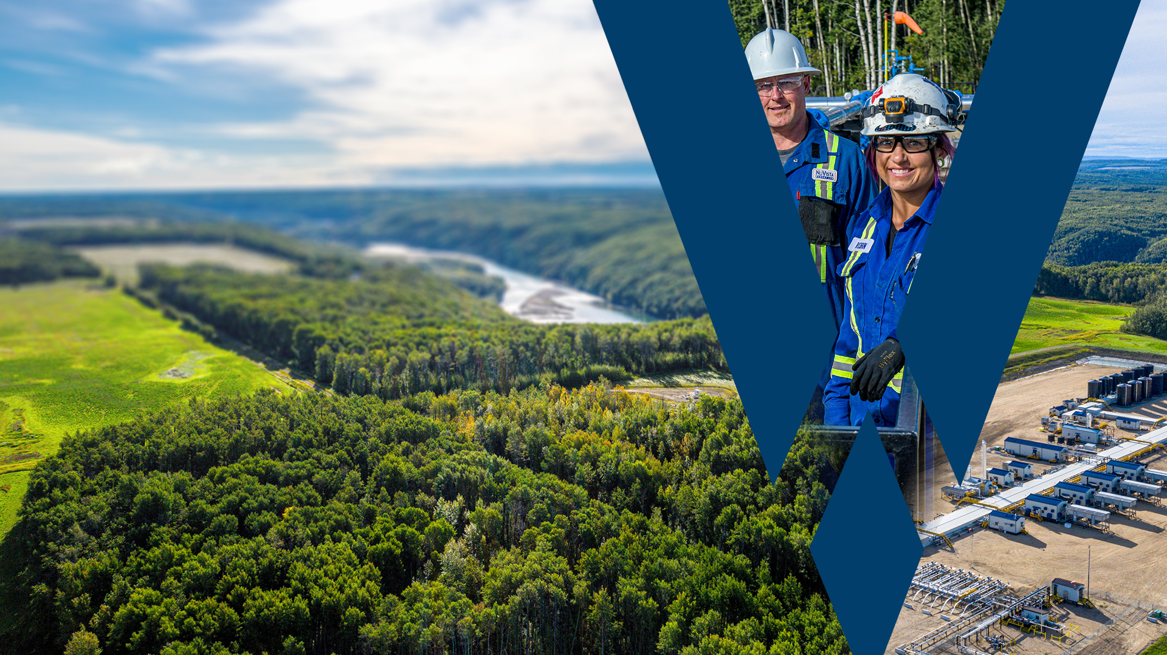
07-31P2 Frac Hits While Fiber Deployed
Feb 2025

Slide 2
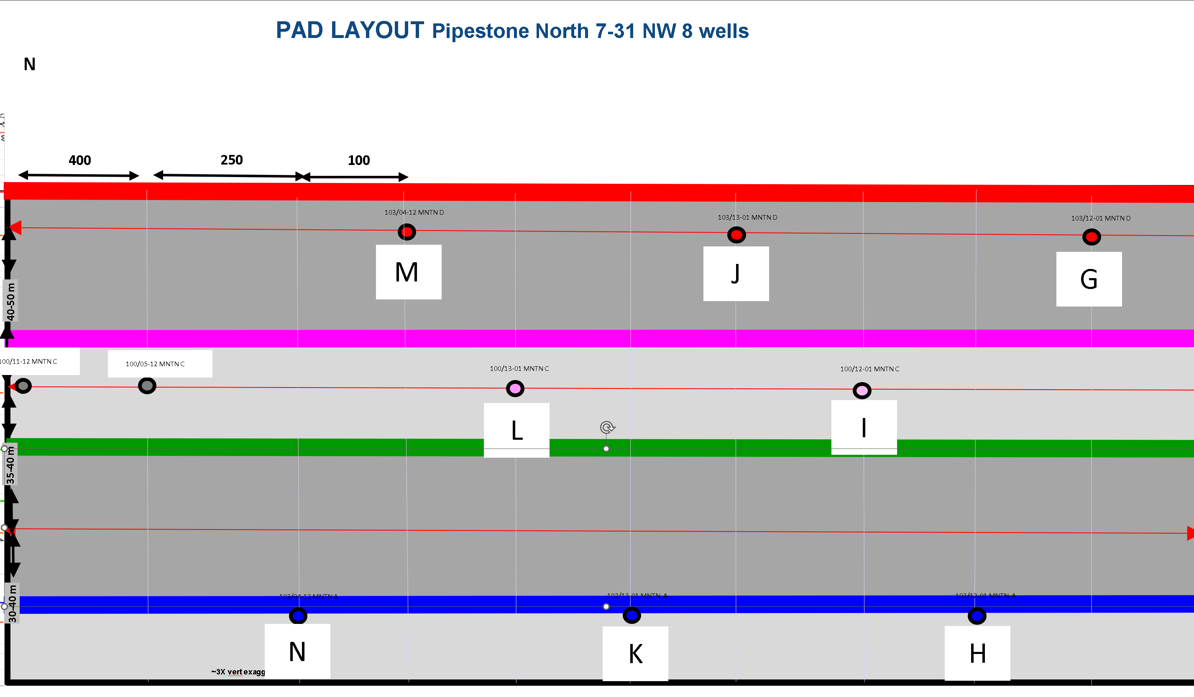
Summary
07-31 P2 Frac Hits During Fiber Deployment
HAL Xpress Fiber Deployed on MNTN C “L” Well from February 12th to February 20th
Two “Non-Classified” Events recorded by Fiber during 1 week of monitoring
Neither event has conclusive strain data or any further insights
NuVista Pressure Monitoring with Surface Gauges Yielded Following Observations during 1 week of Fiber Monitoring
Total of 36 Inter-Pad Pressure Communication Events during Fiber Monitoring Period
Of the 36 Total Events 7 events directly intersected the L well
21 Additional Communication Events with 07-06 Pad
One Pressure Communication Event directly hit the L well during the Fiber Monitoring period when frac’ing in proximity to the open toe port. No associated Xwell/MSM Activity recorded during this recorded pressure communication event.
07-06 offset legacy pad

Slide 3
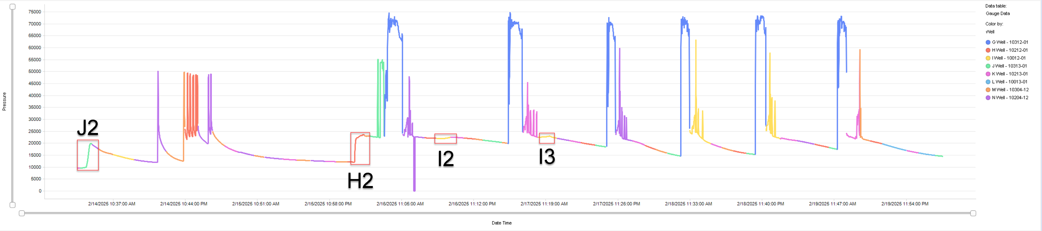
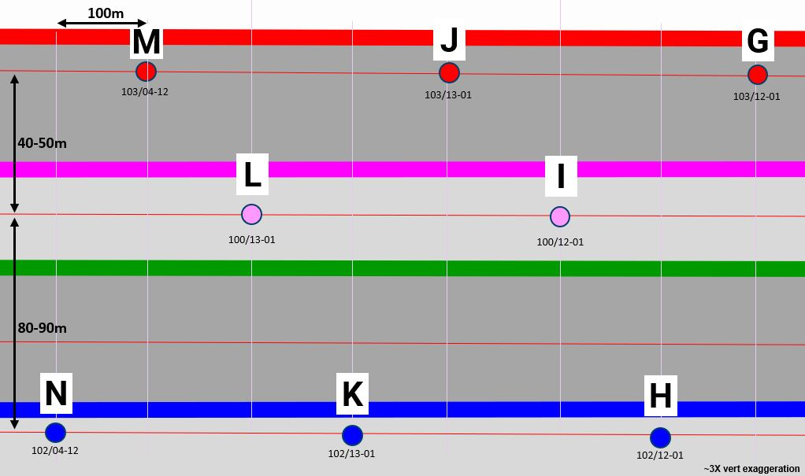
G-Well
Fracking Well | Stage | Pressure Δ (kPa)
J-Well | J2 | 10254.68
H-Well | H2 | 11420.76
I-Well | I2 | 630.97
I-Well | I3 | 424.37

Slide 4
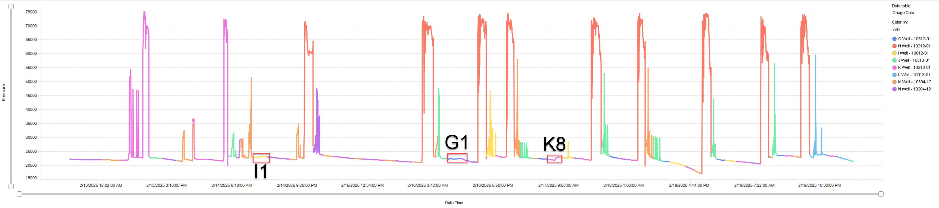
H-Well
Fracking Well | Stage | Pressure Δ (kPa)
I-Well | I1 | 358.98
G-Well | G1 | 234.20
K-Well | K8 | 773.36

Slide 5
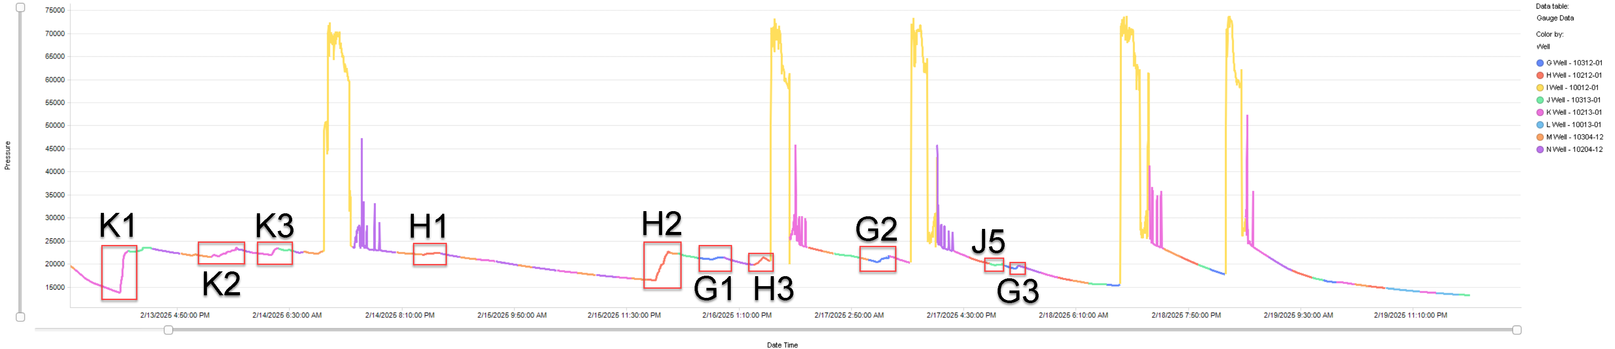
I-Well
Fracking Well | Stage | Pressure Δ (kPa)
K-Well | K1 | 8686.48
K-Well | K2 | 1987.61
K-Well | K3 | 935.64
H-Well | H1 | 358.43
H-Well | H2 | 6085.36
G-Well | G1 | 345.51
H-Well | H3 | 1588.92
G-Well | G2 | 1189.91
J-Well | J5 | 179.35
G-Well | G3 | 469.68

Slide 6
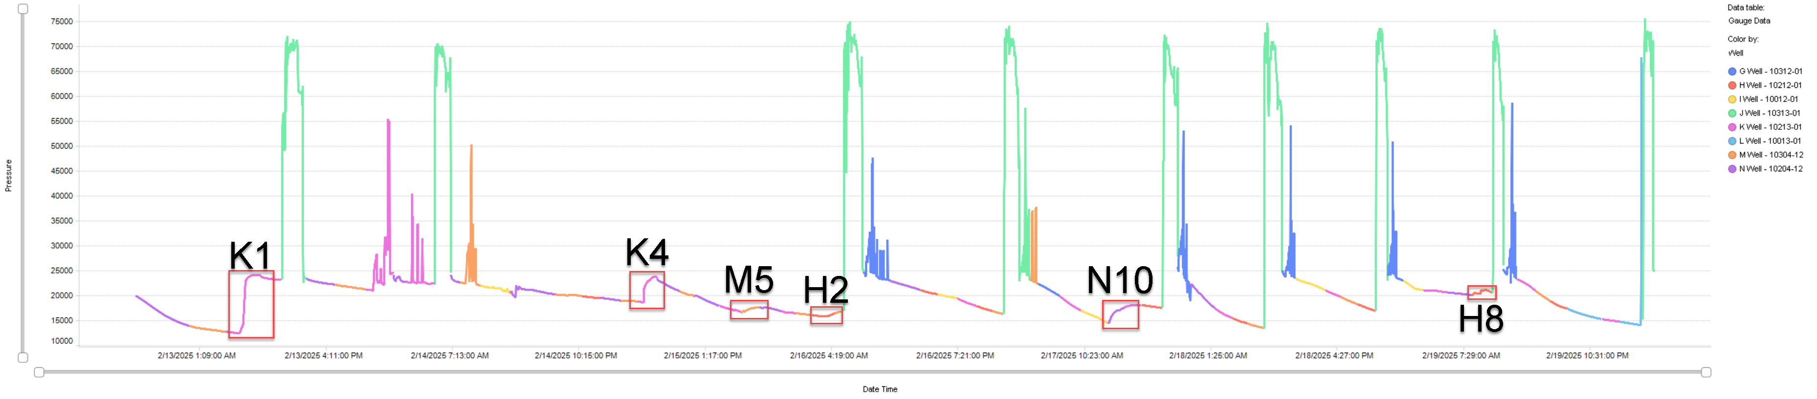
J-Well
Fracking Well | Stage | Pressure Δ (kPa)
K-Well | K1 | 11450.77
K-Well | K4 | 5051.26
M-Well | M5 | 897.76
H-Well | H2 | 909.09
N-Well | N10 | 3605.23
H-Well | H8 | 969.10
Conclusion: 1 pressure event recorded that intersect L well

Slide 7
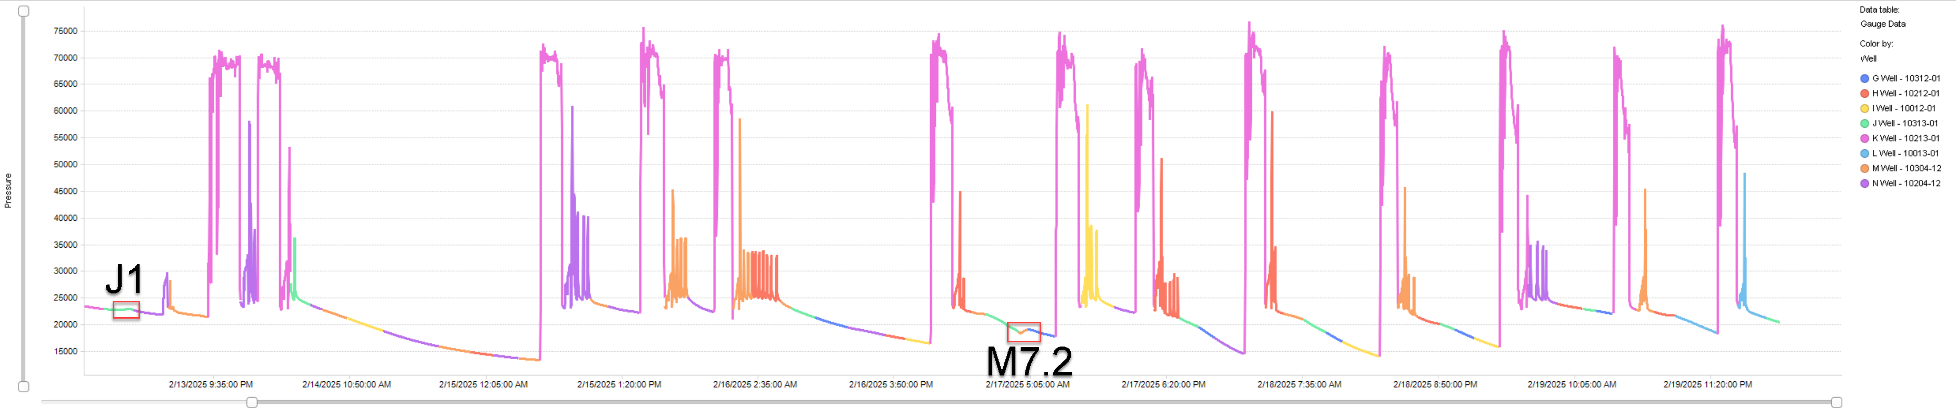
K-Well
Fracking Well | Stage | Pressure Δ (kPa)
J-Well | J1 | 161.18
M-Well | M7.2 | 530.20
Conclusion: 1 pressure event recorded that intersect L well

Slide 8
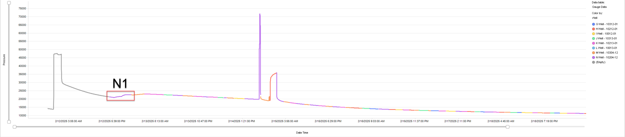
L-Well (Fiber Monitoring Well)
Fracking Well | Stage | Pressure Δ (kPa)
N-Well | N1 | 1668.12
Conclusion: 1 pressure event recorded that hit L well

Slide 9
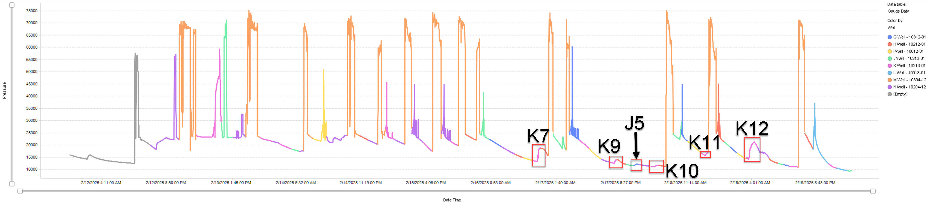
M-Well
Fracking Well | Stage | Pressure Δ (kPa)
K-Well | K7 | 5334.31
K-Well | K9 | 1407.63
J-Well | J5 | 622.70
K-Well | K10 | 600.07
K-Well | K11 | 1240.46
K-Well | K12 | 6856.94
Conclusion: 5 pressure events recorded that intersect L well

Slide 10
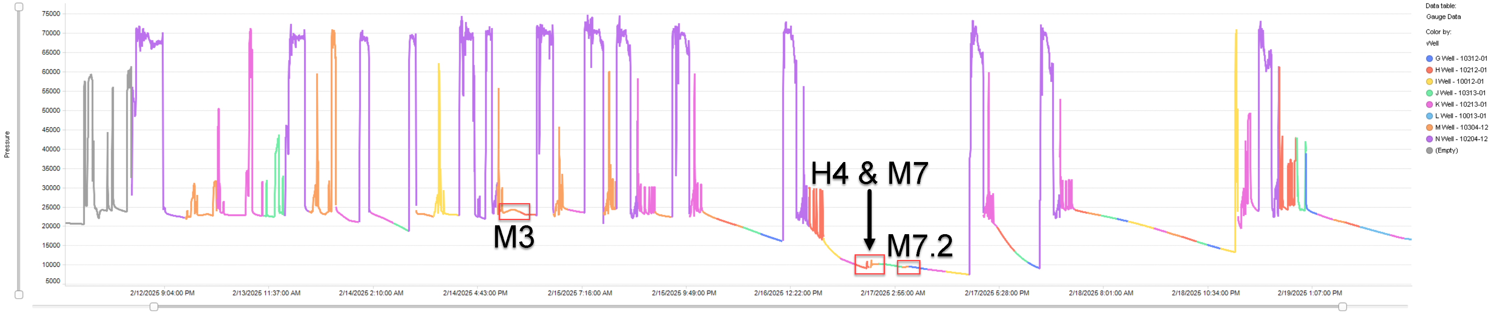
N-Well
Fracking Well | Stage | Pressure Δ (kPa)
M-Well | M3 | 770.26
H-Well | H4 | 1865.26
M-Well | M7 | 1931.80
M-Well | M7.2 | 176.89

Slide 11
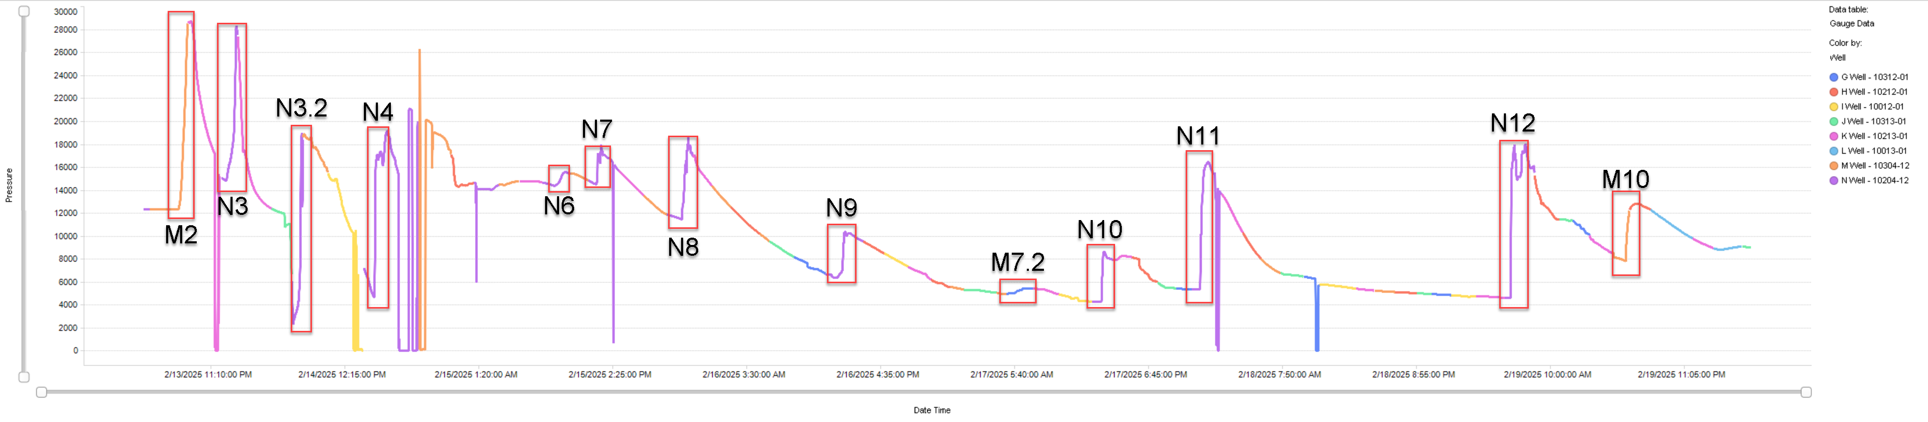
07-06 Pad: 05-12 Well
Fracking Well | Stage | Pressure Δ (kPa)
M-Well | M2 | 16294.56
N-Well | N3 | 12988.69
N-Well | N3.2 | 7563.73
N-Well | N4 | 13381.04
N-Well | N6 | 1077.23
N-Well | N7 | 3136.67
N-Well | N8 | 6508.09
N-Well | N9 | 3993.25
M-Well | M7.2 | 449.25
N-Well | N10 | 4370.62
N-Well | N11 | 10824.78
N-Well | N12 | 13089.64
M-Well | M10 | 4801.12

Slide 12
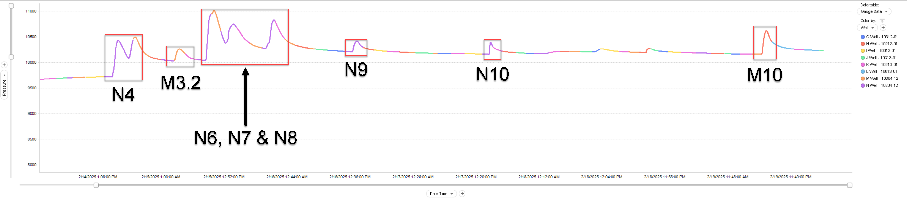
07-06 Pad: 11-12 Well
Fracking Well | Stage | Pressure Δ (kPa)
N-Well | N4 | 785.82
M-Well | M3.2 | 228.79
N-Well | N6 | 974.39
N-Well | N7 | 362.84
N-Well | N8 | 540.14
N-Well | N9 | 204.74
N-Well | N10 | 233.29
M-Well | M10 | 454.1

